Slide 1
Design Patterns: ASP.NET Core
Parameswari Ettiappan

Slide 2

Design Patterns

Slide 3
Goals
Introduction to Patterns
MVC,MVP and MVVM
Language and DSL Pattern
Observer Pattern
Iterator Pattern
Singleton Pattern
Patterns Relating to Factories
Strategy Pattern
Command Pattern

Slide 4
Goals
Proxy Pattern
Template Method Pattern
Decorator and Adapter Pattern
Observer Pattern
Visitor Pattern
State Pattern
ASP.NET Core Architecture
ASP.NET Core Application Development
ASP.NET Core 2.0 Tag Helpers

Slide 5
Goals
Structuring ASP.NET Application
Dependency Injection, Configuring and Entity Framework
TDD
Custom Tag Helpers
Navigation
State Management
Creating Restful Services using WEBAPI
Industry best practices for .NET especially CORE based applications
Efficient way of building project architecture – Do’s & Don’ts
ML applications/use cases (if time permits)

Slide 6
Introduction to Patterns
The Pattern for successful applications
John Lennon once wrote, “There are no problems, only solutions.”
Now, Mr. Lennon did much in the way of ASP.NET programming;
Still what he said is extremely relevant in the realm of software development and probably humanity.
The job as software developers involves solving problems — problems that other developers have had to solve countless times.

Slide 7
Introduction to Patterns
Throughout the lifetime of object-oriented programming, a number of patterns, principles, and best practices have been discovered, named, and catalogued.
With knowledge of these patterns and a common solution vocabulary, we can begin to break down complex problems, encapsulate what varies, and develop applications in a uniformed way with tried and trusted solutions.

Slide 8
Design Patterns Explained
Design patterns are high-level abstract solution templates.
It is blueprint for solutions rather than the solutions themselves.
It is difficult to find a framework that one can simply apply to your application; instead, we will typically arrive at design patterns through refactoring your code and generalizing your problem.
Design patterns aren’t just applicable to software development; design patterns can be found in all areas of life from engineering to architecture.
In fact, it was the architect Christopher Alexander who introduced the idea of patterns in 1970 to build a common vocabulary for design discussion.

Slide 9
Design Patterns Explained
He wrote: The elements of this language are entities called patterns.
Each pattern describes a problem that occurs over and over again in our environment and then describes the core of the solution to that problem in such a way that you can use this solution a million times over without ever doing it the same way twice.
Alexander’s comments are just as applicable to software design as they are to buildings and town planning.

Slide 10
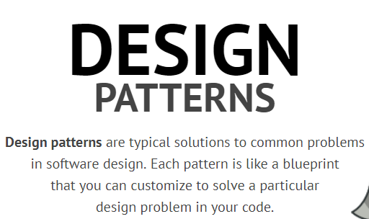

Slide 11
Origins
The origins of the design patterns that are prevalent in software architecture today were born from the experiences and knowledge of programmers over many years of using object-oriented programming languages.
A set of the most common patterns were catalogued in a book entitled Design Patterns: Elements of Reusable Object-Oriented Software, more affectionately known as the Design Patterns Bible.
This book was written by Erich Gamma, Richard Helm, Ralph Johnson, and John Vlissides, better known as the Gang of Four

Slide 12
Origins
They collected 23 design patterns and organized them into 3 groups:
Creational Patterns: These deal with object construction and referencing.
Structural Patterns: These deal with the relationships between objects and how they interact with each other to form larger complex objects.
Behavioral Patterns: These deal with the communication between objects, especially in terms of responsibility and algorithms.

Slide 13
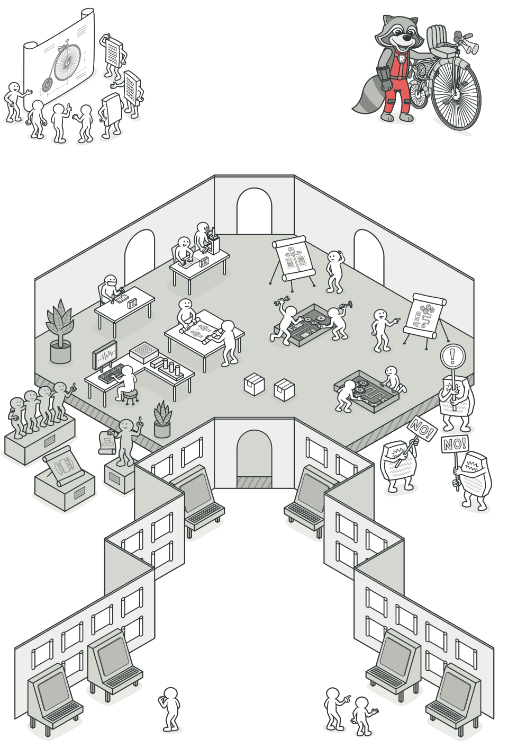
Necessity
Patterns are essential to software design and development.
They enable the expression of intent through a shared vocabulary when problem solving at the design stage as well as within the source code.
Patterns promote the use of good object-oriented software design, as they are built around solid object-oriented design principles.

Slide 14
Necessity
Patterns are an effective way to describe solutions to complex problems.
With solid knowledge of design patterns, you can communicate quickly and easily with other members of a team without having to be concerned with the low-level implementation details.
Patterns are language agnostic; therefore, they are transferable over other object-oriented languages.
The knowledge one gain through learning patterns will serve him in any first-class object-oriented language he decides to program in.

Slide 15
Usefulness
The useful and ultimate value of design patterns lies in the fact that they are tried and tested solutions, which gives confidence in their effectiveness.
For experienced developer and have been programming in .NET or another object-oriented language for a number of years, he might find that he is already using some of the design patterns mentioned in the Gang of Four book.
By being able to identify the patterns what he is using, he must can communicate far more effectively with other developers who, with an understanding of the patterns, will understand the structure of the solution.

Slide 16
Usefulness
Design patterns are all about the reuse of solutions.
All problems are not equal, of course, if you can break down a problem and find the similarities with problems that have been solved before, one can then apply those solutions.
After decades of object-oriented programming, most of the problems we will encounter have been solved countless times before, and there will be a pattern available to assist in solution implementation.
Even if we believe the problem to be unique, by breaking it down to its root elements, one should be able to generalize it enough to find an appropriate solution.
The name of the design pattern is useful because it reflects its behavior and purpose and provides a common vocabulary in solution brainstorming.
It is far easier to talk in terms of a pattern name than in detail about how an implementation of it would work.

Slide 17
What they are not
Design patterns are no silver bullet.
We have to fully understand the problem, generalize it, and then apply a pattern applicable to it.
However, not all problems require a design pattern.
It’s true that design patterns can help make complex problems simple, but they can also make simple problems complex.
After learning patterns, many developers fall into the trap of trying to apply patterns to everything they do, thus achieving quite the opposite of what patterns are all about — making things simple.
The better way to apply patterns is by identifying the fundamental problem that we are trying to solve and looking for a solution that fits it.

Slide 18
What they are not
This training will help with the identification of when and how to use patterns and goes on to cover the implementation from an ASP.NET point of view.
We don’t always have to use design patterns.
If we have arrived at a solution to a problem that is simple but not simplistic and is clear and maintainable.
Don’t force it to fit the pattern.
Otherwise, we will overcomplicate your design.

Slide 19
Common Design Principles
Design pattern is one of the common design patterns.
It has become best practice use design patterns when enterprise-level and maintainable software built.
Keep It Simple Stupid (KISS )
An all-too-common issue in software programming is the need to overcomplicate a solution.
The goal of the KISS principle is concerned with the need to keep code simple but not simplistic, thus avoiding any unnecessary complexities.
Don’t Repeat Yourself (DRY)
The DRY principle aims to avoiding repetition of any part of a system by abstracting out things that are common and placing those things in a single location.
This principle is not only concerned with code but any logic that is duplicated in a system; ultimately there should only be one representation for every piece of knowledge in a system.

Slide 20
Common Design Principles
Tell, Don’t Ask
The Tell, Don’t Ask principle is closely aligned with encapsulation and the assigning of responsibilities to their correct classes.
The principle states that you should to tell objects what actions you want them to perform rather than asking questions about the state of the object and then making a decision yourself on what action you want to perform. This helps to align the responsibilities and avoid tight coupling between classes.
You Ain’t Gonna Need It (YAGNI )
The YAGNI principle refers to the need to only include functionality that is necessary for the application and put off any temptation to add other features that you may think you need.
A design methodology that adheres to YAGNI is test-driven development (TDD).
TDD is all about writing tests that prove the functionality of a system and then writing only the code to get the test to pass.

Slide 21
Common Design Principles
Separation of Concerns (SoC)
SoC is the process of dissecting a piece of software into distinct features that encapsulate unique behavior and data that can be used by other classes.
Generally, a concern represents a feature or behavior of a class.
The act of separating a program into discrete responsibilities significantly increases code reuse, maintenance, and testability.

Slide 22
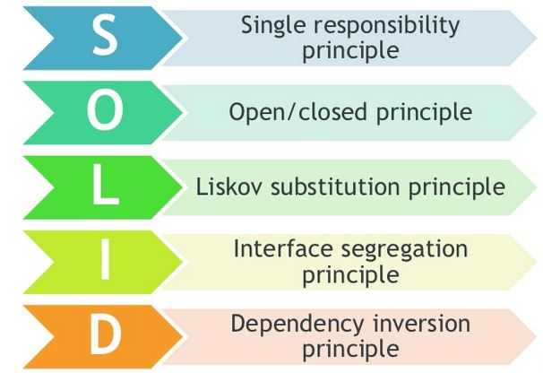
Common Design Principles
The S.O.L.I.D. Design Principles
The S.O.L.I.D. design principles are a collection of best practices for object-oriented design.
All of the Gang of Four design patterns adhere to these principles in one form or another.

Slide 23
Single Responsibility Principle(SRP)
The principle of SRP is closely aligned with SoC(Separation of Concern).
It states that every object should only have one reason to change and a single focus of responsibility.
By adhering to this principle, you avoid the problem of monolithic class design that is the software equivalent of a Swiss army knife.
By having concise objects, you again increase the readability and maintenance of a system.
SRP is a way to divide the whole problem into small parts and each part will be dealt with any separate class.

Slide 24
Open/Closed Principle(OCP)
The OCP states that classes should be open for extension and closed for modification, in that you should be able to add new features and extend a class without changing its internal behavior.
Once you create the class and other parts of the application start using it, you should not change it.
If you change the class it will have impact on the working application and it will break.
If you require additional features you should extend that class rather than modifying it. This way the existing system won’t get any impact from the new change.

Slide 25
Liskov Substitution Principle (LS P)
The LSP dictates that you should be able to use any derived class in place of a parent class and have it behave in the same manner without modification.
This principle is in line with OCP in that it ensures that a derived class does not affect the behavior of a parent class, or, put another way, derived classes must be substitutable for their base classes.

Slide 26
Interface Segregation Principle (ISP)
The ISP is all about splitting the methods of a contract into groups of responsibility and assigning interfaces to these groups to prevent a client from needing to implement one large interface and a host of methods that they do not use.
The purpose behind this is so that classes wanting to use the same interfaces only need to implement a specific set of methods as opposed to a monolithic interface of methods.
Think of a class that has ten methods – five are needed by desktop and five are needed by mobile clients.

Slide 27
Interface Segregation Principle (ISP)
Thus the same interface consisting of ten methods is being used by both desktop and mobile clients.
If desktop application requires some additional methods then we have to add that at interface level and both the application have to be updated to new version.
ISP suggests you avoid such situations, create two separate interfaces one for desktop and another for mobile clients.

Slide 28
Dependency Inversion Principle (DIP)
The DIP is all about isolating your classes from concrete implementations and having them depend on abstract classes or interfaces.
It promotes the mantra of coding to an interface rather than an implementation, which increases flexibility within a system by ensuring you are not tightly coupled to one implementation.

Slide 29
Dependency Injection (DI) and Inversion of Control (IoC)
Closely linked to the DIP are the DI principle and the IOC principle.
DI is the act of supplying a low level or dependent class via a constructor, method, or property.
Used in conjunction with DI, these dependent classes can be inverted to interfaces or abstract classes that will lead to loosely coupled systems that are highly testable and easy to change.

Slide 30
Dependency Injection (DI) and Inversion of Control (IoC)
In IoC, a system’s flow of control is inverted compared to procedural programming.
An example of this is an IoC container, whose purpose is to inject services into client code without having the client code specifying the concrete implementation.
The control in this instance that is being inverted is the act of the client obtaining the service.

Slide 31
Gang of Four Pattern Template
Pattern Name and Classification: The Pattern Name is important because it helps to form the common pattern vocabulary.
The Classification defines the job of the pattern, be it Creational, Structural, or Behavioral.
Intent: The Intent section reveals the problems that the pattern sets out to solve and why it is useful.
Also Known As: The Also Known As section details the other names that some patterns are known as.
Motivation: The Motivation section describes a problem scenario and how to use a design pattern to solve it.

Slide 32
Gang of Four Pattern Template
Applicability: The Applicability section lists the situations when it is advantageous to apply the design pattern.
Structure: The Structure section is a graphical representation of the pattern, including the collaborations and relationships between objects.
Typically this is shown as a UML diagram.
Participants: The Participants are all the objects involved in the design pattern.
Collaborations: The Collaborations section details how the participants work together to form the design pattern.
Consequences: The Consequences section lists any benefits and liabilities caused when implementing the design pattern.

Slide 33
Gang of Four Pattern Template
Implementations: The Implementations section details any gotchas and best practices when implementing the design pattern.
Sample Code: The Sample Code section shows an implementation of the design pattern.
Known Uses: The Known Uses section shows implementations of the pattern in real-life applications.
Related Patterns: The Related Patterns section lists other patterns that collaborate or work well with the design pattern

Slide 34
Design Pattern Groups
Subgroups
Creational, Structural, or Behavioral

Slide 35
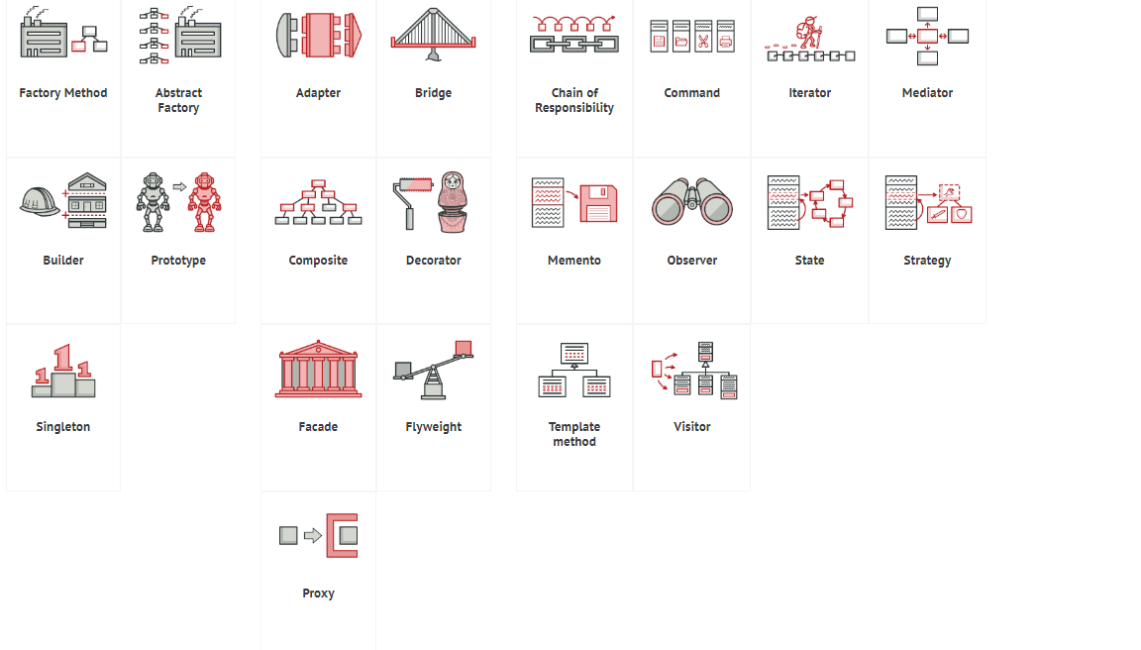

Slide 36
Creational
Creational patterns deal with object construction and referencing.
They abstract away the responsibility of instantiating instances of objects from the client, thus keeping code loosely coupled and the responsibility of creating complex objects in one place adhering to the Single Responsibility and Separation of Concerns principles.

Slide 37
Creational
Following are the patterns in the Creational group:
Abstract Factory: Provides an interface to create families of related objects.
Factory: Enables a class to delegate the responsibility of creating a valid object.
Builder: Enables various versions of an object to be constructed by separating the construction for the object itself.
Prototype: Allows classes to be copied or cloned from a prototype instance rather than creating new instances.
Singleton: Enables a class to be instantiated once with a single global point of access to it.

Slide 38
Structural
Structural patterns deal with the composition and relationships of objects to fulfill the needs of larger systems.
Following are the patterns in the Structural group:
Adapter: Enables classes of incompatible interfaces to be used together.
Bridge: Separates an abstraction from its implementation, allowing implementations and abstractions to vary independently of one another.
Composite: Allows a group of objects representing hierarchies to be treated in the same way as a single instance of an object.

Slide 39
Structural
Decorator: Can dynamically surround a class and extend its behavior.
Facade: Provides a simple interface and controls access to a series of complicated interfaces and subsystems.
Flyweight: Provides a way to share data among many small classes in an efficient manner.
Proxy: Provides a placeholder to a more complex class that is costly to instantiate.

Slide 40
Behavioral
Behavioral patterns deal with the communication between objects in terms of responsibility and algorithms.
The patterns in this group encapsulate complex behavior and abstract it away from the flow of control of a system, thus enabling complex systems to be easily understood and maintained.

Slide 41
Behavioral
Following are the patterns in the Behavioral group:
Chain of Responsibility: Allows commands to be chained together dynamically to handle a request.
Command: Encapsulates a method as an object and separates the execution of a command from its invoker.
Interpreter: Specifies how to evaluate sentences in a language.
Iterator: Provides a way to navigate a collection in a formalized manner.
Mediator: Defines an object that allows communication between two other objects without them knowing about one another.

Slide 42
Behavioral
Memento: Allows you to restore an object to its previous state.
Observer: Defines the way one or more classes can be alerted to a change in another class.
State: Allows an object to alter its behavior by delegating to a separate and changeable state object.
Strategy: Enables an algorithm to be encapsulated within a class and switched at run time to alter an object’s behavior.
Template Method: Defines the control of flow of an algorithm but allows subclasses to override or implement execution steps.
Visitor: Enables new functionality to be performed on a class without affecting its structure.

Slide 43
Categorization of EAA
Domain-logic patterns
Data-source architectural patterns
Object relational behavioural patterns
Object relational structural patterns
Object relational metadata-mapping patterns
Web presentation patterns
Distribution patterns
Offline concurrency patterns
Session-state patterns
Base patterns

Slide 44
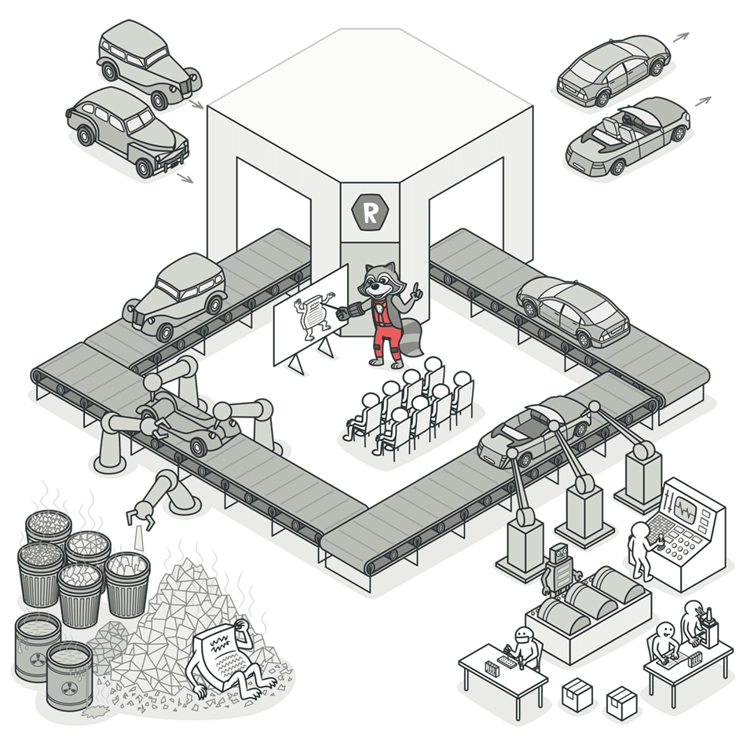
Refactoring
Refactoring is a systematic process of improving codewithout creating new functionality that can transforma mess into clean code and simple design.
Clean Code
Clean code is code that is easy to read,understand and maintain. Clean code makessoftware development predictableand increases the qualityof a resulting product
Dirty Code
While dirty code is often result of laziness and incompetence, it can also pile-up due to shortcuts taken during development process.
Refactoring Techniques
Code Smells
Code smells are indicators of problems that can beaddressed during refactoring. Code smells areeasy to spot and fix, but they may be justsymptoms of a deeper problem with code.

Slide 45
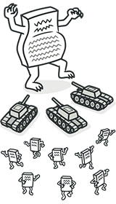
Code Smells
Bloaters
Bloaters are code, methods and classes that have increased to such gargantuan proportions that they are hard to work with. Usually these smells do not crop up right away, rather they accumulate over time as the program evolves (and especially when nobody makes an effort to eradicate them).
Long Method
Large Class
Primitive Obsession
Long Parameter List

Slide 46
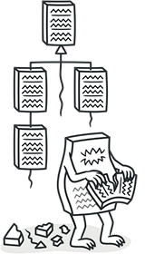
Code Smells
Object-Orientation Abusers
All these smells are incomplete or incorrect application of object-oriented programming principles.
Alternative Classes with Different Interfaces
Refused Request
Switch Statements

Slide 47

Code Smells
Change Preventers
These smells mean that if you need to change something in one place in your code, you have to make many changes in other places too.
Program development becomes much more complicated and expensive as a result.
Divergent Change
Parallel Inheritance Hierarchies
Shotgun Surgery

Slide 48
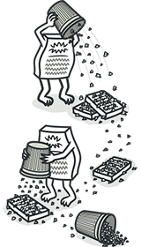
Code Smells
Dispensables
A dispensable is something pointless and unneeded whose absence would make the code cleaner, more efficient and easier to understand.
Comments
Duplicate Code
Data Class
Dead Code
Lazy Class
Speculative Generality

Slide 49
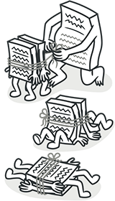
Code Smells
Couplers
All the smells in this group contribute to excessive coupling between classes or show what happens if coupling is replaced by excessive delegation.
Feature Envy
Inappropriate Intimacy
Incomplete Library Class
Message Chains

Slide 50

Refactoring Techniques
Composing Methods
Much of refactoring is devoted to correctly composing methods. In most cases, excessively long methods are the root of all evil. The vagaries of code inside these methods conceal the execution logic and make the method extremely hard to understand – and even harder to change.
The refactoring techniques in this group streamline methods, remove code duplication, and pave the way for future improvements.
Extract Method
Inline Method
Extract Variable
Inline Temp

Slide 51
Refactoring Techniques
Replace Temp with Query
Split Temporary Variable
Remove Assignments to Parameters
Replace Method with Method Object
Substitute Algorithm

Slide 52
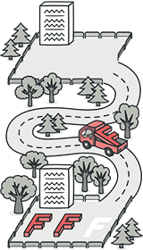
Refactoring Techniques
Moving Features between Objects
Even if you have distributed functionality among different classes in a less-than-perfect way, there is still hope.
These refactoring techniques show how to safely move functionality between classes, create new classes, and hide implementation details from public access.
Move Method
Move Field
Extract Class
Inline Class

Slide 53
Refactoring Techniques
Hide Delegate
Remove Middle Man
Introduce Foreign Method
Introduce Local Extension

Slide 54
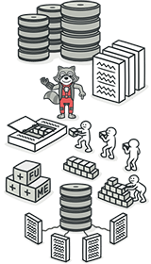
Refactoring Techniques
Organizing Data
These refactoring techniques help with data handling, replacing primitives with rich class functionality. Another important result is untangling of class associations, which makes classes more portable and reusable.
Change Value to Reference
Change Reference to Value
Duplicate Observed Data
Self Encapsulate Field
Replace Data Value with Object

Slide 55
Refactoring Techniques
Replace Array with Object
Change Unidirectional Association to Bidirectional
Change Bidirectional Association to Unidirectional
Encapsulate Field
Encapsulate Collection
Replace Magic Number with Symbolic Constant
Replace Type Code with Class
Replace Type Code with Subclasses
Replace Type Code with State/Strategy
Replace Subclass with Fields

Slide 56
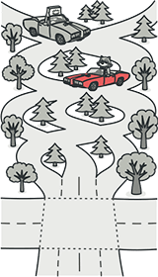
Refactoring Techniques
Simplifying Conditional Expressions
Conditionals tend to get more and more complicated in their logic over time, and there are yet more techniques to combat this as well.
Consolidate Conditional Expression
Consolidate Duplicate Conditional Fragments
Decompose Conditional
Replace Conditional with Polymorphism
Remove Control Flag
Replace Nested Conditional with Guard Clauses

Slide 57
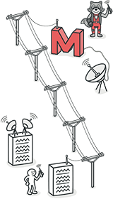
Refactoring Techniques
Simplifying Method Calls
These techniques make method calls simpler and easier to understand. This, in turn, simplifies the interfaces for interaction between classes.
Add Parameter
Remove Parameter
Rename Method
Separate Query from Modifier
Parameterize Method
Introduce Parameter Object
Preserve Whole Object

Slide 58
Refactoring Techniques
Remove Setting Method
Replace Parameter with Explicit Methods
Replace Parameter with Method Call
Hide Method
Replace Constructor with Factory Method
Replace Error Code with Exception
Replace Exception with Test

Slide 59
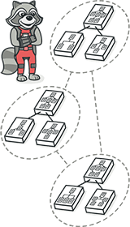
Refactoring Techniques
Dealing with Generalization
Abstraction has its own group of refactoring techniques, primarily associated with moving functionality along the class inheritance hierarchy, creating new classes and interfaces, and replacing inheritance with delegation and vice versa.
Pull Up Field
Pull Up Method
Pull Up Constructor Body
Push Down Field
Push Down Method

Slide 60
Refactoring Techniques
Extract Subclass
Extract Superclass
Extract Interface
Collapse Hierarchy
Form Template Method
Replace Inheritance with Delegation
Replace Delegation with Inheritance

Slide 61
MVC, MVP and MVVM
MVC Pattern
MVC stands for Model-View-Controller. It is a software design pattern which was introduced in 1970s.
Also, MVC pattern forces a separation of concerns, it means domain model and controller logic are decoupled from user interface (view).
As a result maintenance and testing of the application become simpler and easier.
MVC design pattern splits an application into three main aspects: Model, View and Controller

Slide 62
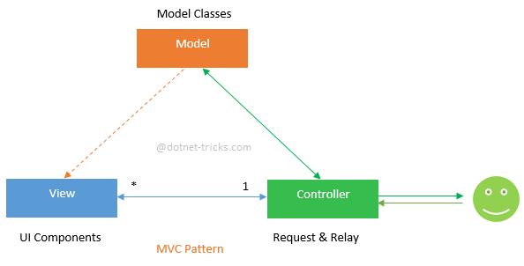
MVC, MVP and MVVM
Today, this pattern is used by many popular framework like as Ruby on Rails, Spring Framework, Apple iOS Development and ASP.NET MVC.

Slide 63
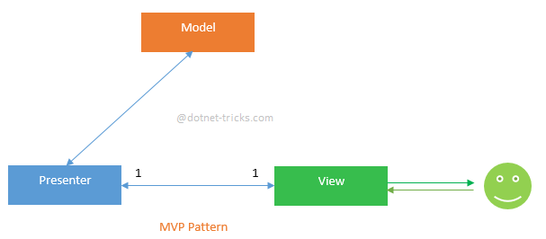
MVC, MVP and MVVM
MVP pattern
This pattern is similar to MVC pattern in which controller has been replaced by the presenter. This design pattern splits an application into three main aspects: Model, View and Presenter.
This pattern is commonly used with ASP.NET Web Forms applications which require to create automated unit tests for their code-behind pages. This is also used with windows forms.

Slide 64
MVC, MVP and MVVM
Presenter
The Presenter is responsible for handling all UI events on behalf of the view.
This receive input from users via the View, then process the user's data with the help of Model and passing the results back to the View.
Unlike view and controller, view and presenter are completely decoupled from each other’s and communicate to each other’s by an interface.
Also, presenter does not manage the incoming request traffic as controller.

Slide 65
MVC, MVP and MVVM
Key Points about MVP Pattern:
User interacts with the View.
There is one-to-one relationship between View and Presenter means one View is mapped to only one Presenter.
View has a reference to Presenter but View has not reference to Model.
Provides two way communication between View and Presenter.

Slide 66
MVC, MVP and MVVM
MVVM pattern
MVVM stands for Model-View-View Model. This pattern supports two-way data binding between view and View model.
This enables automatic propagation of changes, within the state of view model to the View.
Typically, the view model uses the observer pattern to notify changes in the view model to model.

Slide 67
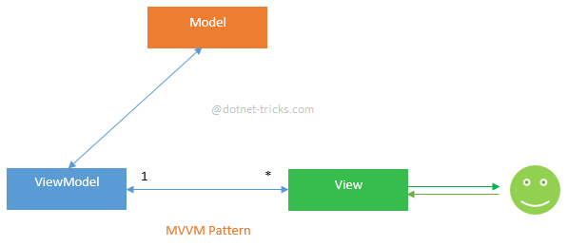
MVC, MVP and MVVM
View Model
The View Model is responsible for exposing methods, commands, and other properties that helps to maintain the state of the view, manipulate the model as the result of actions on the view, and trigger events in the view itself

Slide 68
MVC, MVP and MVVM
Key Points about MVVM Pattern:
User interacts with the View.
There is many-to-one relationship between View and ViewModel means many View can be mapped to one ViewModel.
View has a reference to ViewModel but View Model has no information about the View.
Supports two-way data binding between View and ViewModel.

Slide 69
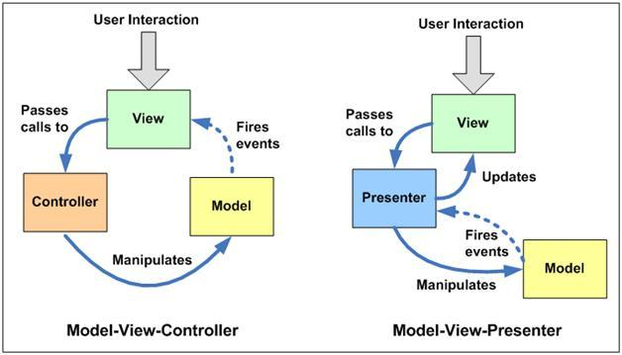

Slide 70
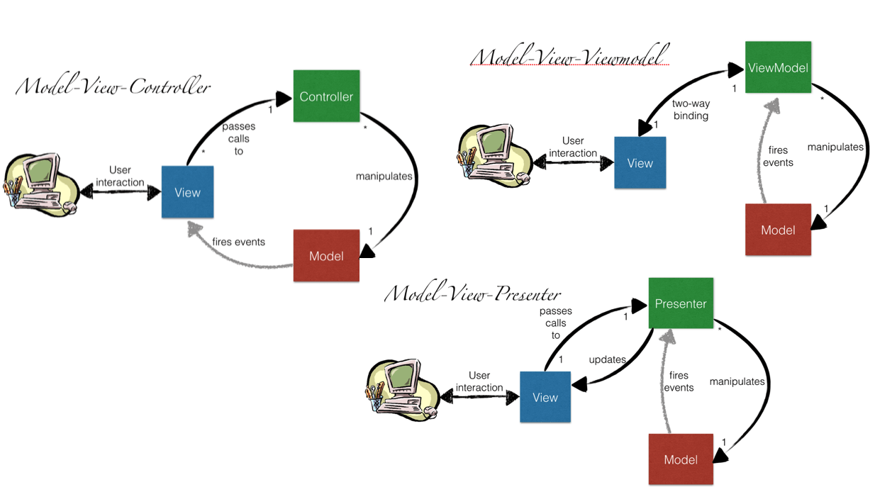

Slide 71
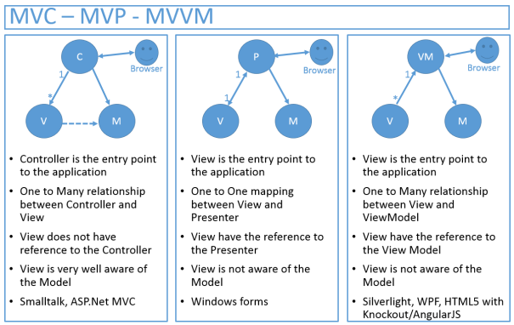

Slide 72
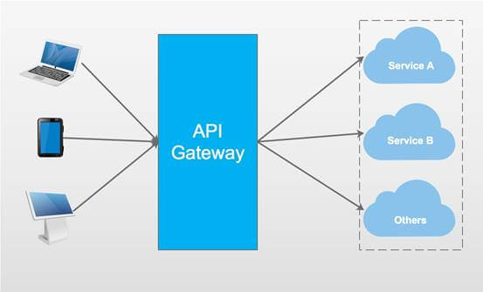
Ocelot API Gateway

Slide 73
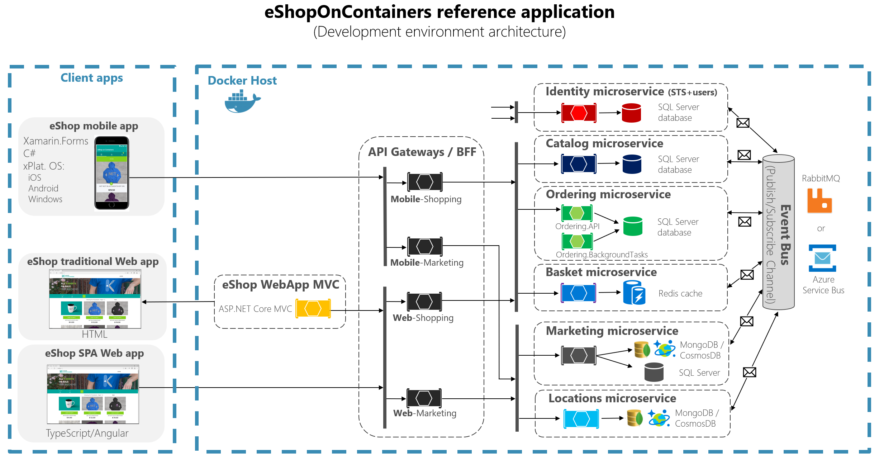
Microservice

Slide 74
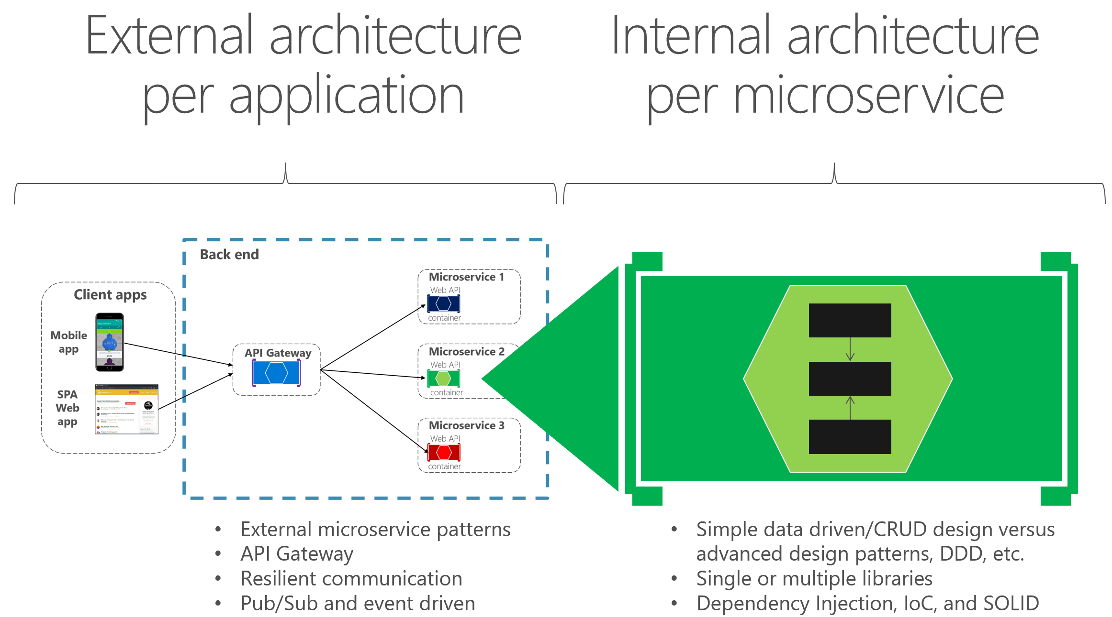
Microservice

Slide 75
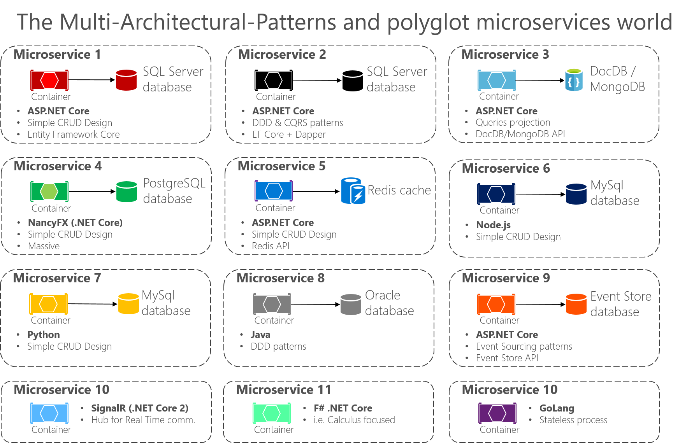

Slide 76
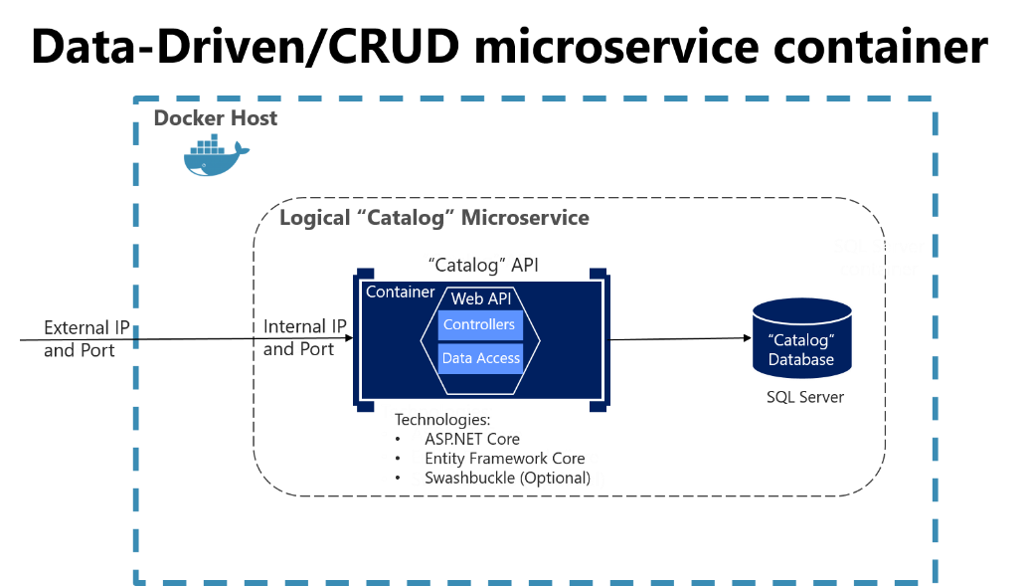

Slide 77
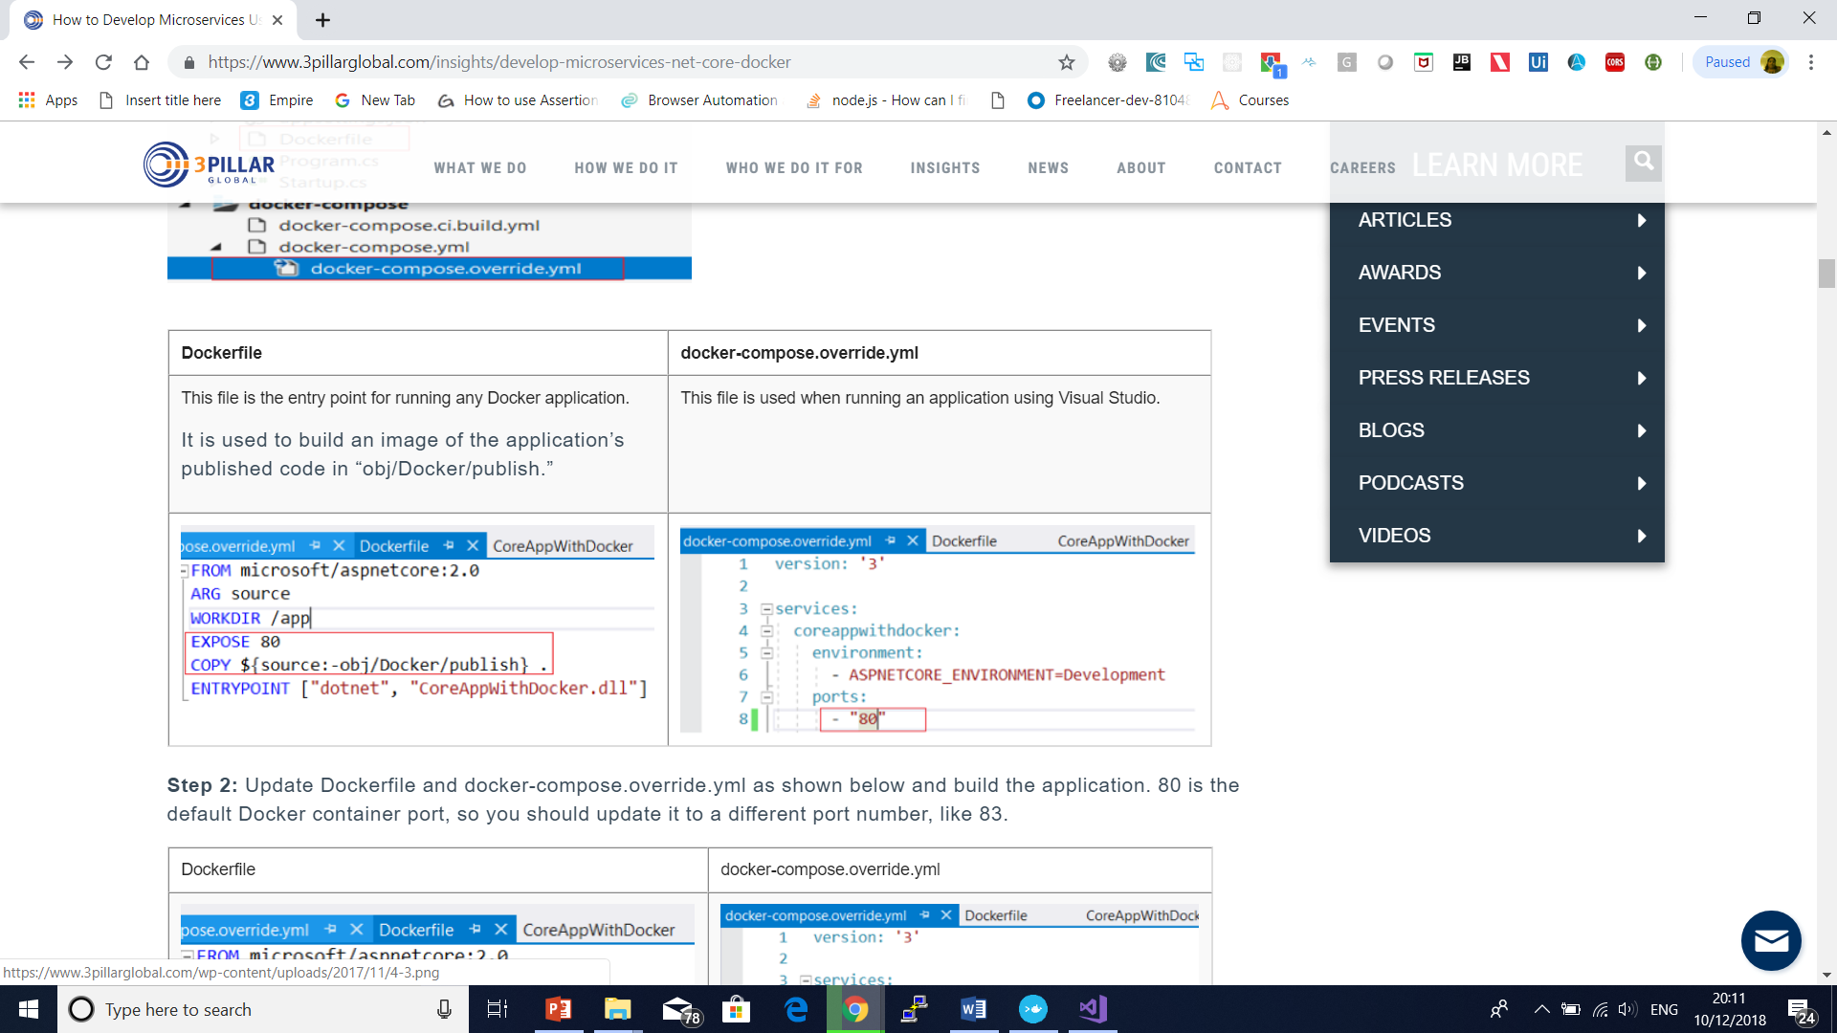

Slide 78
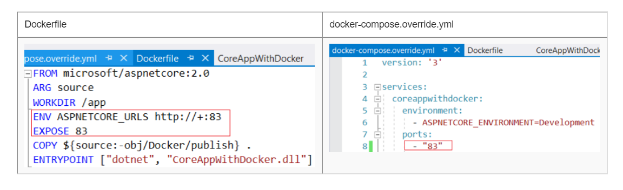

Slide 79
Docker ps commands
Docker ps –a –q
Docker rm $(docker ps –a –q)
Dotnet restore
dotnet publish -o obj/Docker/publish
docker build -t imagename .
docker run -d -p 8001:83 –name core1 coreappimage

Slide 80
DSL
A domain-specific language (DSL) is designed to express statements in a particular problem space, or domain.
Well-known DSLs include regular expressions and SQL.
Each DSL is much better than a general-purpose language for describing operations on text strings or a database, but much worse for describing ideas that are outside its own scope.
Individual industries also have their own DSLs.
For example, in the telecommunications industry, call description languages are widely used to specify the sequence of states in a telephone call, and in the air travel industry a standard DSL is used to describe flight bookings.

Slide 81
DSL Applications
Plan of navigation paths in a website.
Wiring diagrams for electronic components.
Networks of conveyor belts and baggage handling equipment for an airport.

Slide 82
DSL benefits
Contains constructs that exactly fit the problem space.
An insurance policy application must include elements for policies and claims.
A domain-specific language makes it easier to design the application, and find and correct errors of logic.
Lets non-developers and people who do not know the domain understand the overall design.
By using a graphical domain-specific language, you can create a visual representation of the domain so that non-developers can easily understand the design of the application.

Slide 83
DSL benefits
Makes it easier to create a prototype of the final application.
Developers can use the code that their model generates to create a prototype application that they can show to clients.

Slide 84
The DSL Tools Solution
Task Flow
Class Diagrams
Minimal Language
Component Models
Minimal WPF
Minimal Windows.Forms
DSL Library

Slide 85
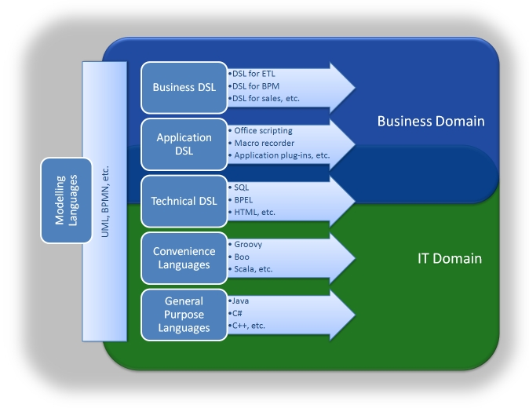
Implementing a Domain Specific Language on .NET

Slide 86
Creational Pattern
Singleton Pattern
GoF Definition
Ensure a class has only one instance, and provide a global point of access to it.
Concept
A particular class should have only one instance. You can use this instance whenever you need it and therefore avoid creating unnecessary objects.

Slide 87
Creational Pattern
Real-Life Example
Suppose you are a member of a sports team and your team is participating in a tournament.
When your team plays against another team, as per the rules of the game, the captains of the two sides must have a coin toss.
If your team does not have a captain, you need to elect someone to be the captain first.
Your team must have one and only one captain.

Slide 88
Creational Pattern
Computer World Example
In some software systems, you may decide to maintain only one file system so that you can use it for the centralized management of resources.

Slide 89
Creational Pattern
Illustration
These are the key characteristics in the following implementation:
• The constructor is private in this example. So, you cannot instantiate in a normal fashion (using new).
Before you attempt to create an instance of a class, you check whether you already have an available copy.
If you do not have any such copy, you create it; otherwise, you simply reuse the existing copy.

Slide 90
Singleton Design Pattern

Slide 91
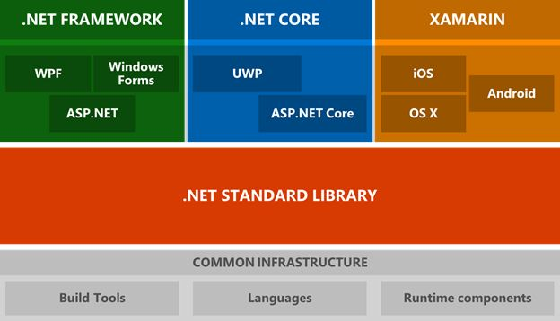
.net core

Slide 92
Decision
.NET Framework is a better choice if you:
Do not have time to learn a new technology.
Need a stable environment to work in.
Have nearer release schedules.
Are already working on an existing app and extending its functionality.
Already have an existing team with .NET expertise and building production ready software.
Do not want to deal with continuous upgrades and changes.
Building Windows client applications using Windows Forms or WPF

Slide 93
Decision
. NET Core is a better choice if you:
Want to target your apps on Windows, Linux, and Mac operating systems.
Are not afraid of learning new things.
Are not afraid of breaking and fixing things since .NET Core is not fully matured yet.
A student who is just learning .NET.
Love open source.

Slide 94
Decision
High-performance and scalable system without UI | .NET Core is much faster.
Docker containers support | Both. But .NET Core is born to live in a container.
Heavily reply on command line | .NET Core has a better support.
Cross-platform needs | .NET Core
Using Microservices | Both but .NET Core is designed to keep in mind today's needs.
User interface centric Web applications | .NET Framework is better now until .NET Core catches up.
Windows client applications using Windows Forms and WPF | .NET Framework
Already have a pre-configured environment and systems | .NET Framework is better.
Stable version for immediate need to build and deploy | .NET Framework has a been around since 2001. .NET Core is just a baby.
Have existing experienced .NET team | .NET Core has a learning curve.
Time is not a problem. Experiments are acceptable. No rush to deployment. | .NET Core is the future of .NET.

Slide 95
Alternative Approach for single threaded model
public static Singleton Instance
{
get
{
if (instance == null)
{
instance = new Singleton();
}
return instance;
}
}

Slide 96
Alternative Approach for single threaded model
//Double checked locking
using System;
public sealed class Singleton
{
//We are using volatile to ensure that
//assignment to the instance variable finishes before it’s
//access.
private static volatile Singleton instance;
private static object lockObject = new Object();
private Singleton() { }

Slide 97
Alternative Approach for single threaded model
public static Singleton Instance
{
get
{
if (instance == null)
{
lock (lockObject)
{
if (instance == null)
instance = new Singleton();
}
}
return instance;
}
}

Slide 98
Singleton
The volatile keyword indicates that a field might be modified by multiple threads that are executing at the same time.
Fields that are declared volatile are not subject to compiler optimizations that assume access by a single thread.
This ensures that the most up-todate value is present in the field at all times.
In simple terms, the volatile keyword can help you to provide a serialize access mechanism.
In other words, all threads will observe the changes by any other thread as per their execution order.
You will also remember that the volatile keyword is applicable for class (or struct) fields; you cannot apply it to local variables.

Slide 99
Prototype Pattern
GoF Definition
Specify the kinds of objects to create using a prototypical instance, and create new objects by copying this prototype.
Concept
This pattern provides an alternative method for instantiating new objects by copying or cloning an instance of an existing object.
You can avoid the expense of creating a new instance using this concept.

Slide 100
Prototype Pattern
Real-Life Example
Suppose you have a master copy of a valuable document.
You need to incorporate some change into it to analyze the effect of the change.
In this case, you can make a photocopy of the original document and edit the changes in the photocopied document.
Computer World Example
Let’s assume that you already have an application that is stable.
In the future, you may want to modify the application with some small changes.
You must start with a copy of your original application, make the changes, and then analyze further.
Surely you do not want to start from scratch to merely make a change; this would cost you time and money.

Slide 101
Prototype Pattern

Slide 102
Prototype Pattern
What are the advantages of using the Prototype design pattern?
Answer:
• You can include or discard products at runtime.
• In some contexts, you can create new instances with a cheaper cost.
• You can focus on the key activities rather than focusing on
complicated instance creation processes.
• Clients can ignore the complex creation process for objects and instead clone or copy objects.

Slide 103
Prototype Pattern
What are the challenges associated with using the Prototype design pattern?
Answer:
• Each subclass must implement the cloning or copying mechanism.
• Implementing the cloning mechanism can be challenging if the objects under consideration do not support copying or if there are circular references.
• In this example, I have used the MemberwiseClone() member that performs a shallow copy in C#.
Actually, it creates an object and then copies the non static fields of the current object into the newly created object.
MSDN further says that for a value type field, it performs a bit-by-bit copy, but for a reference type field, the references are copied but referred objects are not copied. So, the original object and the cloned object both refer to the same object.
If you need a deep copy in your application, that can be expensive.

Slide 104
Prototype Pattern
A shallow copy creates a new object and then copies the non static fields from the original object to the new object.
If there exists a value type field in the original object, a bit-by-bit copy is performed.
But if the field is a reference type, this method will copy the reference, not the actual object.

Slide 105
Builder Pattern
GoF Definition
Separate the construction of a complex object from its representation so that the same construction processes can create different representations.
Concept
The Builder pattern is useful for creating complex objects that have multiple parts.
The creation process of an object should be independent of these parts; in other words, the construction process does not care how these parts are assembled.
In addition, you should be able to use the same construction process to create different representations of the objects.

Slide 106
Builder Pattern

Slide 107
Builder Pattern
Here, Product is the complex object under consideration.
ConcreteBuilder constructs and assembles the parts of a Product object by implementing an abstract interface called Builder.
The ConcreteBuilder objects builds the internal representations of the products and defines the creation process and assembly mechanisms.
Director is responsible for creating the final object using the Builder interface.

Slide 108
Builder Pattern
Real-Life Example
To complete an order for a computer, different hardware parts are assembled based on customer preferences. For example, a customer can opt for a 500GB hard disk with an Intel processor, and another customer can choose a 250GB hard disk with an AMD processor.
Computer World Example
You can use this pattern when you want to convert one text format to another text format, such as converting from RTF to ASCII.

Slide 109
Builder Pattern

Slide 110
Builder Pattern Advantages
You direct the builder to build the objects step-by-step, and you promote encapsulation by hiding the details of the complex construction process.
The director can retrieve the final product from the builder when the whole construction is over.
In general, at a high level, you seem to have only one method that makes the complete product, but other internal methods are involved in the creation process. So, you have finer control over the construction process.
Using this pattern, the same construction process can produce different products.
• You can also vary the internal representation of products.

Slide 111
Builder Pattern Drawbacks
Answer:
• It is not suitable if you want to deal with mutable objects (which can be modified later).
• You may need to duplicate some portion of the code. These duplications may have significant impact in some contexts.
• To create more products, you need to create more concrete builders.

Slide 112
Factory Method
GoF Definition
Define an interface for creating an object, but let subclasses decide which class to instantiate.
The Factory Method pattern lets a class defer instantiation to subclasses.
Real-Life Example
In a restaurant, based on customer inputs, a chef varies the taste of dishes to make the final products.

Slide 113
Factory Method
GoF Definition
Define an interface for creating an object, but let subclasses decide which class to instantiate.
The Factory Method pattern lets a class defer instantiation to subclasses.
Real-Life Example
In a restaurant, based on customer inputs, a chef varies the taste of dishes to make the final products.

Slide 114
Factory Method
Computer World Example
In an application, you may have different database users. For example, one user may use Oracle, and the other may use SQL Server.
Whenever you need to insert data into your database, you need to create either a SqlConnection or an OracleConnection and only then can you proceed.
If you put the code into if-else (or switch) statements, you need to repeat a lot of code, which isn’t easily maintainable.
This is because whenever you need to support a new type of connection, you need to reopen your code and make those modifications. This type of problem can be resolved using the Factory Method pattern.
Here I’ll provide an abstract creator class (IAnimalFactory) to define the basic structure.
As per the definition, the instantiation process will be carried out through the subclasses that derive from this abstract class.

Slide 115
Factory Method

Slide 116
Abstract Factory Pattern

Slide 117
Observer Pattern
GoF Definition
Define a one-to-many dependency between objects so that when one object changes state, all its dependents are notified and updated automatically.
Concept
In this pattern, there are many observers (objects) that are observing a particular subject (also an object).
Observers want to be notified when there is a change made inside the subject.
So, they register themselves to that subject.
When they lose interest in the subject, they simply unregister from the subject.
Sometimes this model is referred as the Publisher-Subscriber model. The whole idea can be summarized as follows: using this pattern, an object (subject) can send notifications to multiple observers (a set of objects) at the same time.

Slide 118
Observer Pattern

Slide 119
Observer Pattern
Real-Life Example
Think about a celebrity who has many followers on social media.
Each of these followers wants to get all the latest updates from their favorite celebrity.
So, they follow the celebrity until their interest wanes.
When they lose interest, they simply do not follow that celebrity.
Think of each of these fans or followers as an observer and the celebrity as the subject.

Slide 120
Observer Pattern
Computer World Example
In the world of computer science, consider a simple UI-based example.
This UI is connected to some database.
A user can execute some query through that UI, and after searching the database, the result is returned in the UI.
With this pattern, you segregate the UI from the database.
If a change occurs in the database, the UI should be notified so that it can update its display according to the change.

Slide 122
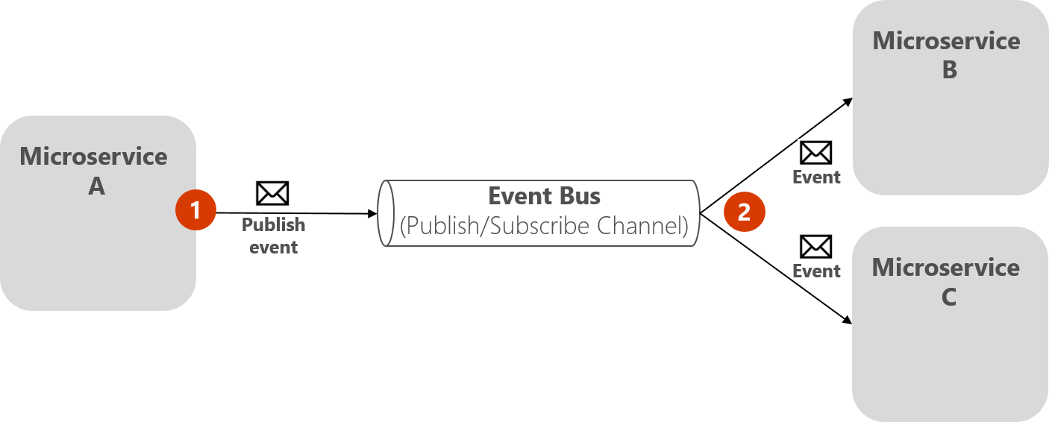
The event bus
An event bus allows publish/subscribe-style communication between microservices without requiring the components to explicitly be aware of each other
The event bus is related to the Observer pattern and the publish-subscribe pattern.

Slide 123
Observer Pattern
In the Observer pattern, your primary object (known as the Observable) notifies other interested objects (known as Observers) with relevant information (events).

Slide 124
Publish/Subscribe (Pub/Sub) pattern
The purpose of the Publish/Subscribe pattern is the same as the Observer pattern: you want to notify other services when certain events take place.
But there is an important difference between the Observer and Pub/Sub patterns.
In the observer pattern, the broadcast is performed directly from the observable to the observers, so they “know” each other.
But when using a Pub/Sub pattern, there is a third component, called broker or message broker or event bus, which is known by both the publisher and subscriber.
Therefore, when using the Pub/Sub pattern the publisher and the subscribers are precisely decoupled thanks to the mentioned event bus or message broker.

Slide 125
The middleman or event bus
How do you achieve anonymity between publisher and subscriber? An easy way is let a middleman take care of all the communication. An event bus is one such middleman.
An event bus is typically composed of two parts:
The abstraction or interface.
One or more implementations.

Slide 126
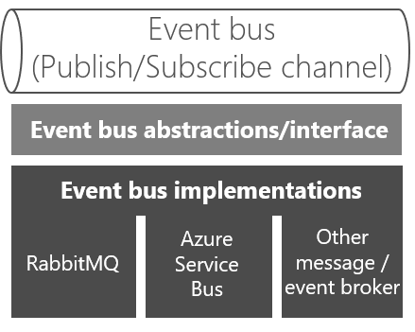

Slide 127
Iterator Pattern
GoF Definition
Provide a way to access the elements of an aggregate object sequentially without exposing its underlying representation.

Slide 128
Iterator Pattern
Concept
Iterators are generally used to traverse a container (which is basically an object) to access its elements, but you do not need to deal with the element’s internal details.
You will frequently use the concepts of iterators when you want to traverse different kinds of collection objects in a standard and uniform way.
This concept is used frequently to traverse the nodes of a tree-like structure. So, in many scenarios, you may notice the use of the Iterator pattern with the Composite pattern.
C# has its own iterators that were introduced in Visual Studio 2005.
The foreach statement is frequently used in this context..

Slide 129
Iterator Pattern
Real-Life Example
Suppose there are two companies, Company A and Company B. Company A stores its employee records (say each employee’s name, address, salary details, and so on) in a linked list data structure, and Company B stores its employee data in an array.
One day the two companies decide to merge. The Iterator pattern becomes handy in such a situation because you do need not to write any code from scratch.
In a situation like this, you can have a common interface through which you can access the data for both companies. So, you can simply call those methods without rewriting the code.

Slide 130
Iterator Pattern
Computer World Example
Similarly suppose, in a college, the arts department is using an array data structure to maintain its student records, and the science department is using a linked list data structure to keep its student records.
The administrative department does not care about the different data structures.
It is simply interested in getting the data from each department and wants to access the data in a uniform way.

Slide 131
Iterator Pattern

Slide 132
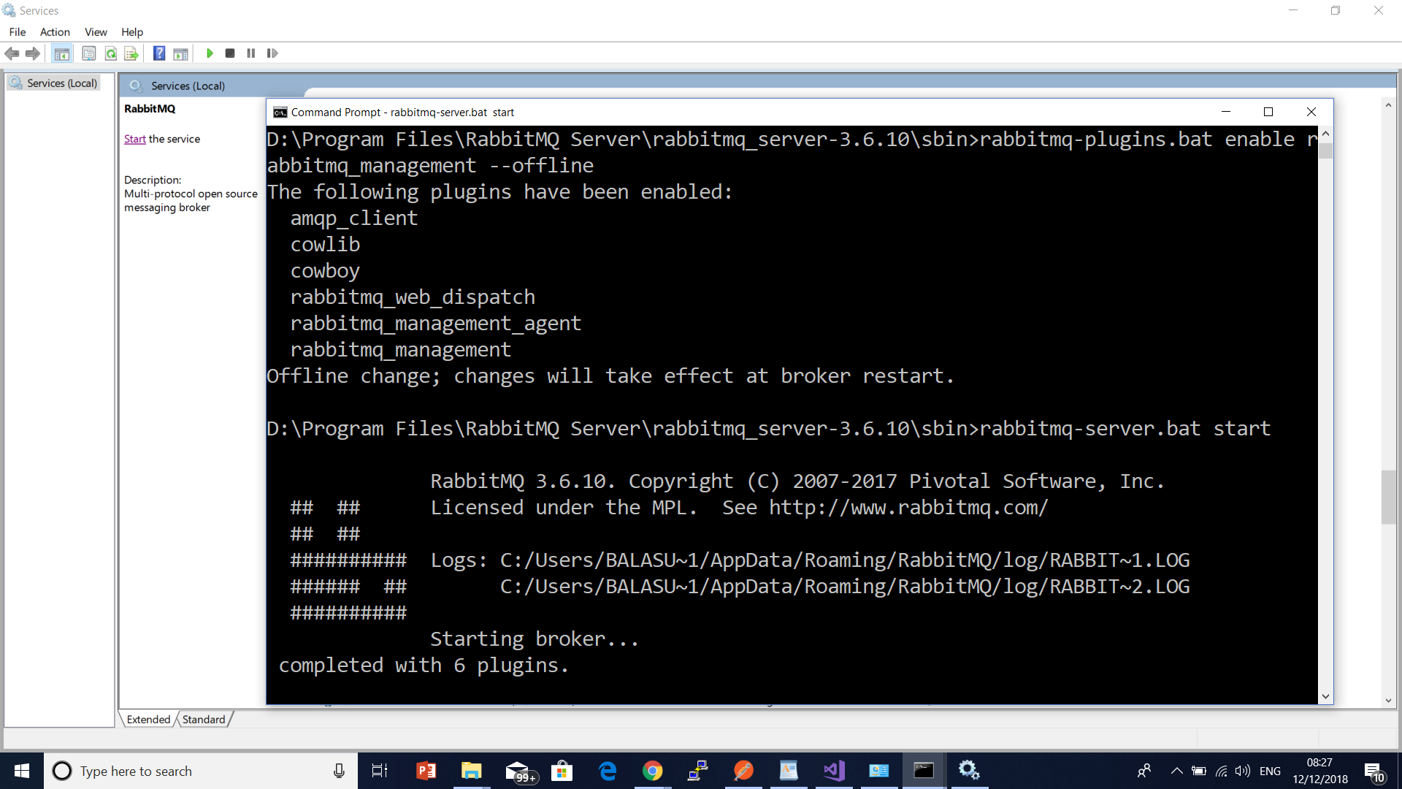

Slide 133
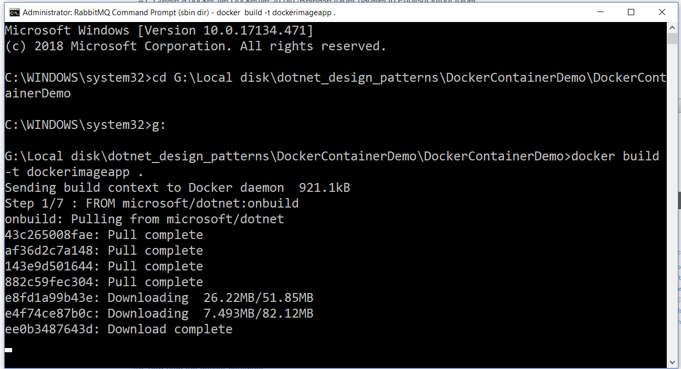
Containerization

Slide 134
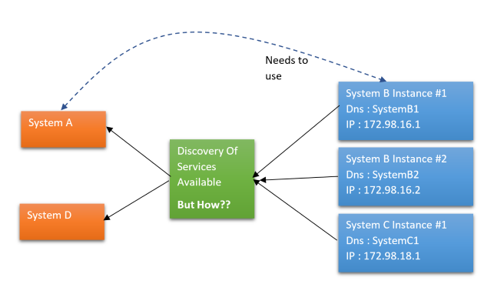
Discovery Pattern

Slide 135
Existing solutions
Why do developers choose Zookeeper?
High performance ,easy to generate node specific config
Kafka support
Java
Supports extensive distributed IPC
Spring Boot Support
Supports DC/OS
Embeddable In Java Service
Used in Hadoop

Slide 136
Existing solutions
Consul
Infrastructure
Health checking
Distributed key-value store
Monitoring
High-availability
Web-UI
Token-based acls
Gossip clustering
Dns server
Docker integration

Slide 137
Existing solutions
Redis/DataStore
You could use Redis cache to be used by services to store meta data, and then a consumer could query the cache.
However to make this resilient you really need some form of clustering, and some consensus/gossip to achieve consistency.
This is fairly hard so most people just cut corners and make this a singleton, which is obviously a single point of failure.
.

Slide 138
Existing solutions
Kubernetes
Kubernetes does a good job of "Disvovery" by way of Services/DNS addon/pods all of which can easily be load balanced.
This is a great solution to run in containers (preferably in a cloud environment)
Consul
Consul (to my mind) is the only tool/framework that tackles "discovery" head on, and actually provides a rich tool that does that this job, and does it well, with little effort from the developer.

Slide 139
Configuring Consul in Local workstation
Download from Consul portal. Choose particular package based on the operating System. Once downloaded the zip, we need to unzip it to desired place.
Start Consul Agent in local workstation – The Zip file that we have unzipped, has only one exe file called consul.exe. We will start a command prompt here and use below command to start the agent.
IPV4 is binding address.
consul agent -server -bootstrap-expect=1 -data-dir=consul-data -ui -bind=192.168.99.1

Slide 140
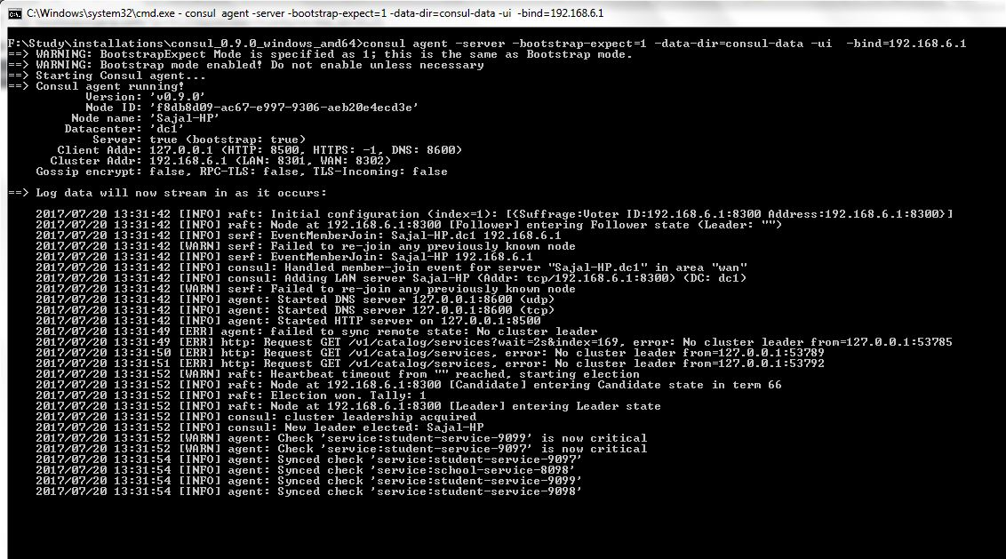
Configuring Consul in Local workstation

Slide 141
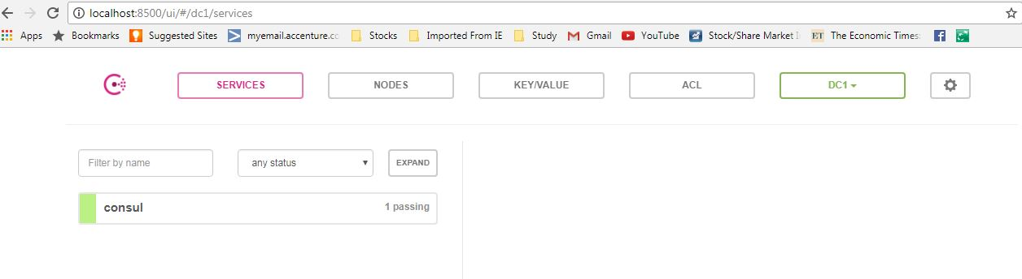
Configuring Consul in Local workstation
Test whether Consul Server is running – Consul runs on default port and once agent started successfully, browse http://localhost:8500/uiand you should see a console screen like –

Slide 142
Consul Web
Registered services
The cluster nodes
The Key/Values for the KeyValueStore
Any ACL (Access Control List) values you have setup

Slide 143
Consul
Install-Package consul

Slide 144
PWA
PWAs are just websites, enhanced using modern design and web technologies (Responsive Design, Touch Friendly, Service Workers, Fetch networking, Cache API, Push notifications, Web App Manifest) to provide a more native app-like experience.

Slide 145
PWA
Manifest, Service Worker, Secure:
To create a PWA the website will need: a manifest, service workers, and be on Https:
Standard manifest file: The site requires a manifest file to define the features and behavior of the PWA. The file follows the W3C standard. This includes everything from images, to language, or the start page of your web app.
Service workers: The Progressive Web App should have a mechanism (e.g. through a service worker) to help control traffic when the network isn’t there or isn’t reliable. The app should be able to work independent of network.
Secure: A secure connection (HTTPS) over your site makes sure all traffic is as safe as a native app. A secure endpoint also allows the service worker to securely take action on the behalf of your app.
.

Slide 146
PWA
Manifest, Service Worker, Secure:
The manifest defines some details for your site if it's downloaded, which includes custom splash-screens, icon-standards and more.
It also prompts the user to install it as a PWA, via an install-banner, if they visit the site frequently on a phone.
This is one of the core properties of a PWA (Progressive Web App) since it gives the immersive App part.

Slide 147
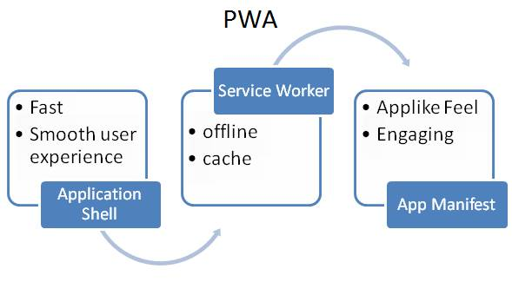
PWA
Progressive Web Apps are applications that use modern web capabilities to provide a mobile application-like experience to users via the web.

Slide 148
Progressive Web Apps are
Reliable Service Workers enable PWA to load instantly, regardless of the network state. It never shows that awful dinosaur screen, even if there is no network.
Fast Application Shell makes it faster and provides a smooth user experience.
Engaging Manifest makes more engaging web apps. Manifest file makes PWA installable and live on the user’s home screen. We can even make the users re-engaged with the help of push notifications.
Progressive Works for every user, regardless of browser.
Safe PWA Served via HTTPS to prevent snooping and ensure the security of content.
Linkable It can be easily shared via URL.

Slide 149
Proxy Pattern
Provide a surrogate or placeholder for another object to control access to it.
Concept
A proxy is basically a substitute for an intended object.
When a client deals with a proxy object, it thinks that it is dealing with the actual object.
You need to support this kind of design because dealing with an original object is not always possible.
This is because of many factors such as security issues, for example.
So, in this pattern, you may want to use a class that can perform as an interface to something else.

Slide 150
Proxy Pattern
An ATM implementation will hold proxy objects for bank information that exists on a remote server.
In the real programming world, creating multiple instances of a complex object (a heavy object) is costly in general.
So, whenever you can, you should create multiple proxy objects that can point to the original object.
This mechanism can also help you to save the computer/system memory.

Slide 152
Strategy (Policy) Pattern
Define a family of algorithms, encapsulate each one, and make them interchangeable.
Strategy lets the algorithm vary independently from clients that use it.
Concept
You can select the behavior of an algorithm dynamically at runtime.

Slide 153
Strategy (Policy) Pattern
Suppose you have a backup memory slot.
If your primary memory is full and you need to store more data, you can store it in the backup memory slot.
If you do not have this backup memory slot and you try to store additional data into your primary memory (when it is full), then that data will be discarded, you will receive exceptions, or you will encounter some peculiar behavior (based on the architecture of the program).
So, a runtime check is necessary before storing the data, and then you can proceed

Slide 154
Moq Framework

Slide 155
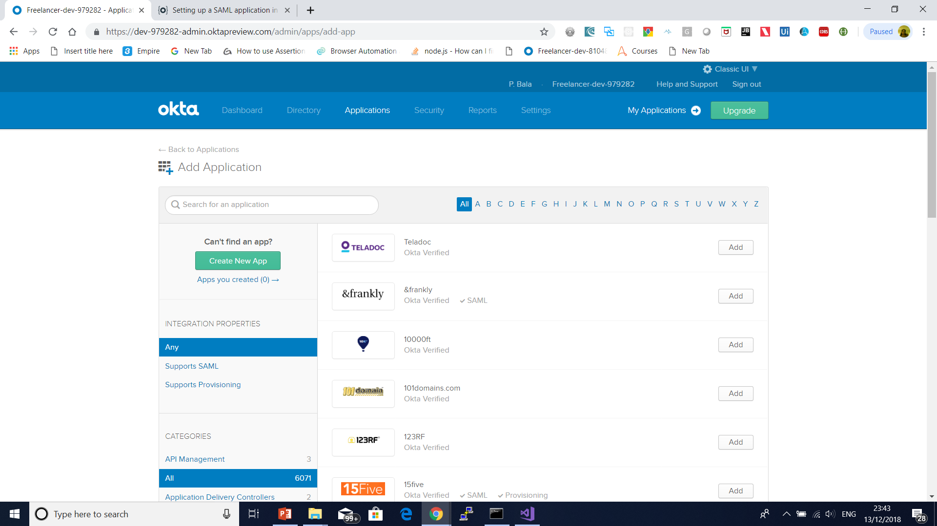
Switch to classic ui

Slide 156
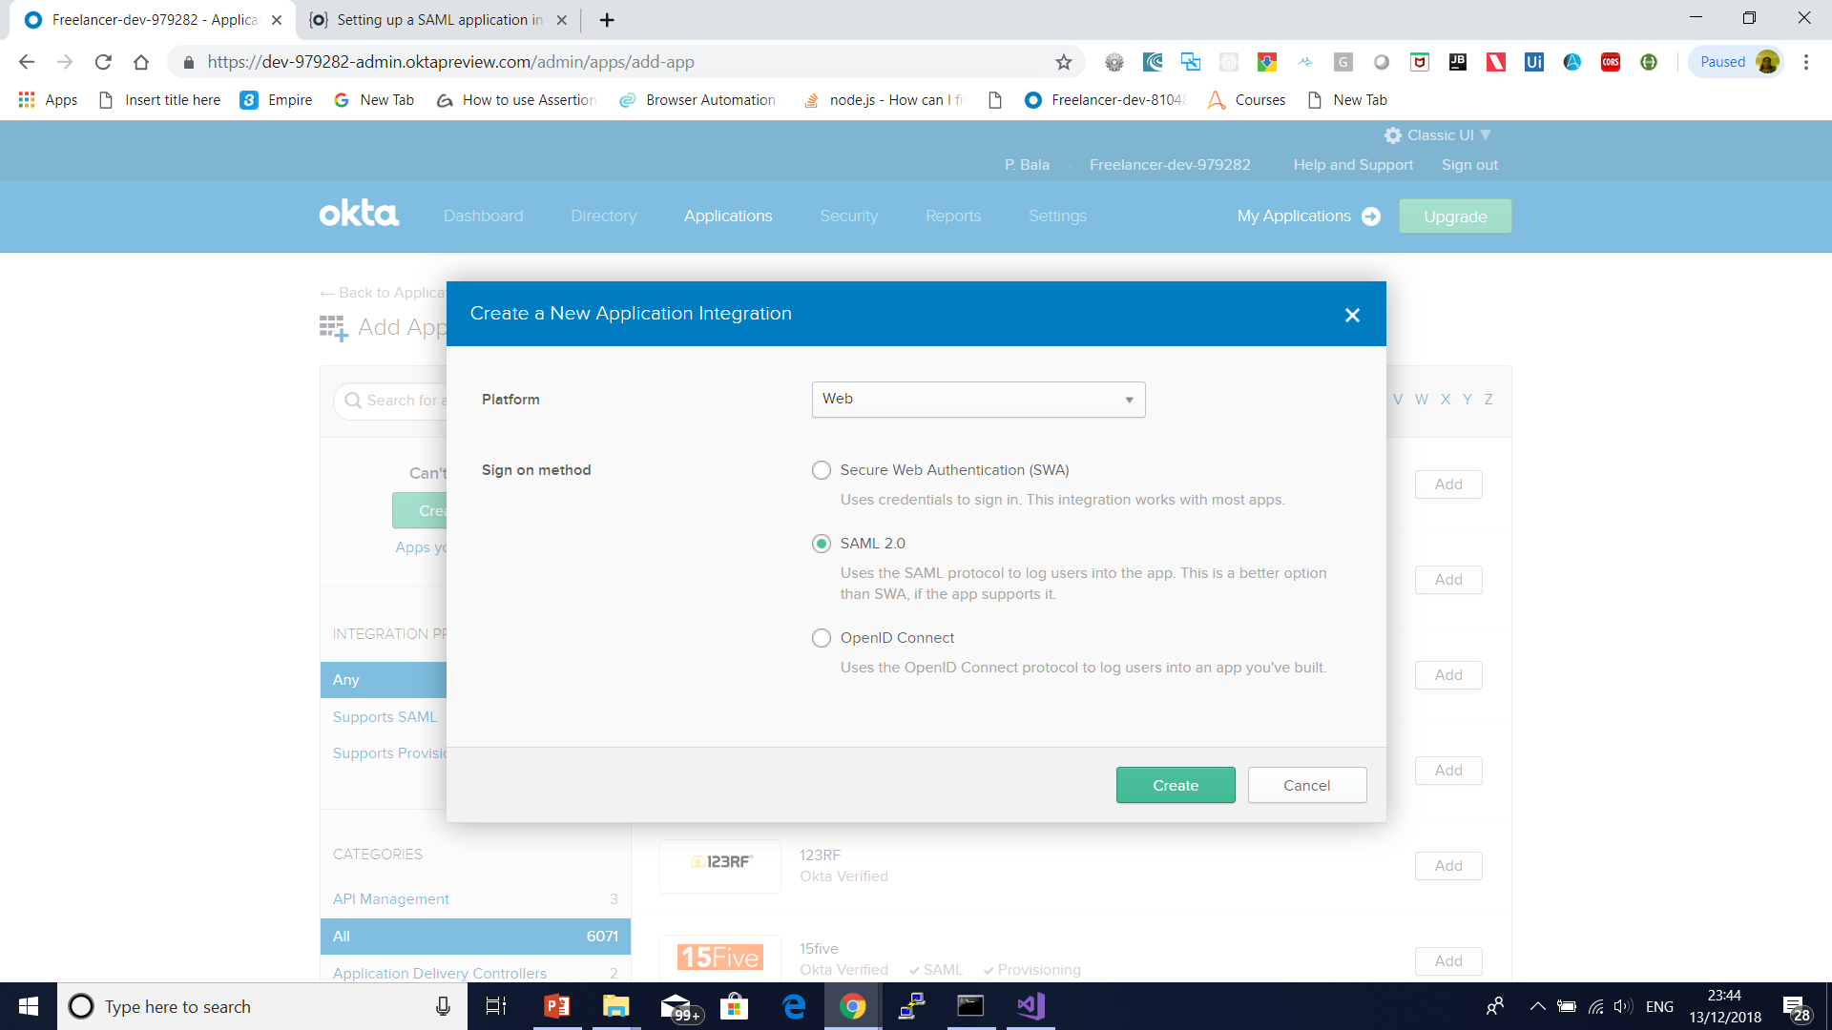

Slide 157
Preview SAML
<?xml version="1.0" encoding="UTF-8"?>
<saml2:Assertion
xmlns:saml2="urn:oasis:names:tc:SAML:2.0:assertion" ID="id8452218445246736637109369" IssueInstant="2018-12-13T18:19:26.791Z" Version="2.0">
<saml2:Issuer Format="urn:oasis:names:tc:SAML:2.0:nameid-format:entity">http://www.okta.com/Issuer</saml2:Issuer>
<saml2:Subject>
<saml2:NameID Format="urn:oasis:names:tc:SAML:1.1:nameid-format:unspecified">userName</saml2:NameID>
<saml2:SubjectConfirmation Method="urn:oasis:names:tc:SAML:2.0:cm:bearer">
<saml2:SubjectConfirmationData NotOnOrAfter="2018-12-13T18:24:27.004Z" Recipient="http://example.com/saml/sso/example-okta-com"/>
</saml2:SubjectConfirmation>
</saml2:Subject>
<saml2:Conditions NotBefore="2018-12-13T18:14:27.004Z" NotOnOrAfter="2018-12-13T18:24:27.004Z">
<saml2:AudienceRestriction>
<saml2:Audience>http://example.com/saml/sso/example-okta-com</saml2:Audience>
</saml2:AudienceRestriction>
</saml2:Conditions>
<saml2:AuthnStatement AuthnInstant="2018-12-13T18:19:26.791Z">
<saml2:AuthnContext>
<saml2:AuthnContextClassRef>urn:oasis:names:tc:SAML:2.0:ac:classes:PasswordProtectedTransport</saml2:AuthnContextClassRef>
</saml2:AuthnContext>
</saml2:AuthnStatement>
</saml2:Assertion>

Slide 158
SAML Authentication Steps
https://developer.okta.com/standards/SAML/setting_up_a_saml_application_in_okta
Client Id 0oaibarqtmkLjQy0o0h7
Client Secret KM48VeTKtPW0W2_Vh5iOy95Ej6aHMuDWvjtXBGVK

Slide 159
Template method pattern
GoF Definition
Define the skeleton of an algorithm in an operation, deferring some steps to subclasses.
The Template Method pattern lets subclasses redefine certain steps of an algorithm without changing the algorithm’s structure

Slide 160
Template method pattern
With the Template Method pattern, you define the minimum or essential structure of an algorithm.
Then you defer some responsibility to the subclasses. The key idea is that you can redefine certain steps of an algorithm, but those changes will not impact the core architecture.

Slide 161
Template method pattern
The Template Method pattern makes sense when you want to avoid duplicate code in your application but allow subclasses to change some specific details of the base class workflow to bring varying behavior to the application.

Slide 162
Template Pattern

Slide 163
Decorator
GoF Definition
Attach additional responsibilities to an object dynamically.
Decorators provide a flexible alternative to subclassing for extending functionality.

Slide 164
Decorator
This pattern promotes the concept that your class should be closed for modification but open for extension.
In other words, you can add a functionality without disturbing the existing functionalities.
The concept is useful when you want to add some special functionality to a specific object instead of the whole class.
This pattern prefers object composition over inheritance.
Once you master this technique, you can add new responsibilities to an object without affecting the underlying classes

Slide 165
Decorator
Suppose you own a single-story house and you decide to build a second floor on top of it.
Obviously, you may not want to change the architecture of the ground floor.
But you may want to change the design of the architecture for the newly added floor without affecting the existing architecture.

Slide 166
Decorator
Suppose in a GUI-based toolkit you want to add some border properties.
You could do this with inheritance, but that cannot be treated as an ultimate solution because you do not have absolute control over everything from the beginning.
So, this technique is static in nature.
Decorators offer a flexible approach. They promote the concept of dynamic choices.
For example, you can surround the component in another object. The enclosing object is termed a decorator, and it must conform to the interface of the component that it decorates.
It will forward the requests to the component, and it can perform additional operations before or after those requests. In fact, you can add an unlimited number of responsibilities with this concept.

Slide 167
Decorator

Slide 168
State Pattern
Allow an object to alter its behavior when its internal state changes. The object will appear to change its class.
The concept is best described by the following examples.
Consider the scenario of a network connection, say a TCP connection.
An object can be in various states; for example, a connection might already be established, a connection might be closed, or the object has already started listening through the connection.
When this connection receives a request from other objects, it responds as per its present state.

Slide 169
State Pattern
Suppose you have a job-processing system that can process a certain number of jobs at a time.
When a new job appears, either the system processes the job or it signals that the system is busy with the maximum number of jobs that it can process at a time.
In other words, the system will send a busy signal if it gets another job-processing request when its total number of job-processing capabilities has been reached.

Slide 170
State Pattern

Slide 171
State Pattern

Slide 172
Visitor Pattern
GoF Definition
Represent an operation to be performed on the elements of an object structure.
Visitor lets you define a new operation without changing the classes of the elements on which it operates.

Slide 173
Visitor Pattern
Concept
With this pattern, you separate an algorithm from an object structure.
So, you can add new operations without modifying the existing architecture.
This pattern supports the open/close principle (which says extension is allowed but modification is disallowed for entities such as class, function, modules, and so on)..

Slide 174
Visitor Pattern
Think of a taxi-booking scenario.
When the taxi arrives at your door and you enter the vehicle, the visiting taxi takes control of the transportation.
It can take you to your destination through a new route that you are not familiar with, and in the worst case, it can alter the destination.

Slide 175
Visitor Pattern
This pattern is useful when public APIs need to support plug-in operations.
Clients can then perform their intended operations on a class (with the visiting class) without modifying the source.

Slide 176
Visitor Pattern

Slide 177
Questions

Slide 178
Module Summary
Desing patterns
EE Patterns
How to use
DSL
Creational Pattern

